Slide 1
Kentucky District 3 Warren County
Field Exercise – 8/29/2026

Slide 2
Specifics
8/29/2026
Start at 09:30CDT
Repeater 1 – 147.165 +0.60MHz
Repeater 2 – 143.330 +0.60MHz PL 107.2
Simplex 1 – 146.430
Simplex 2 – 147.430
Using HT Only

Slide 3
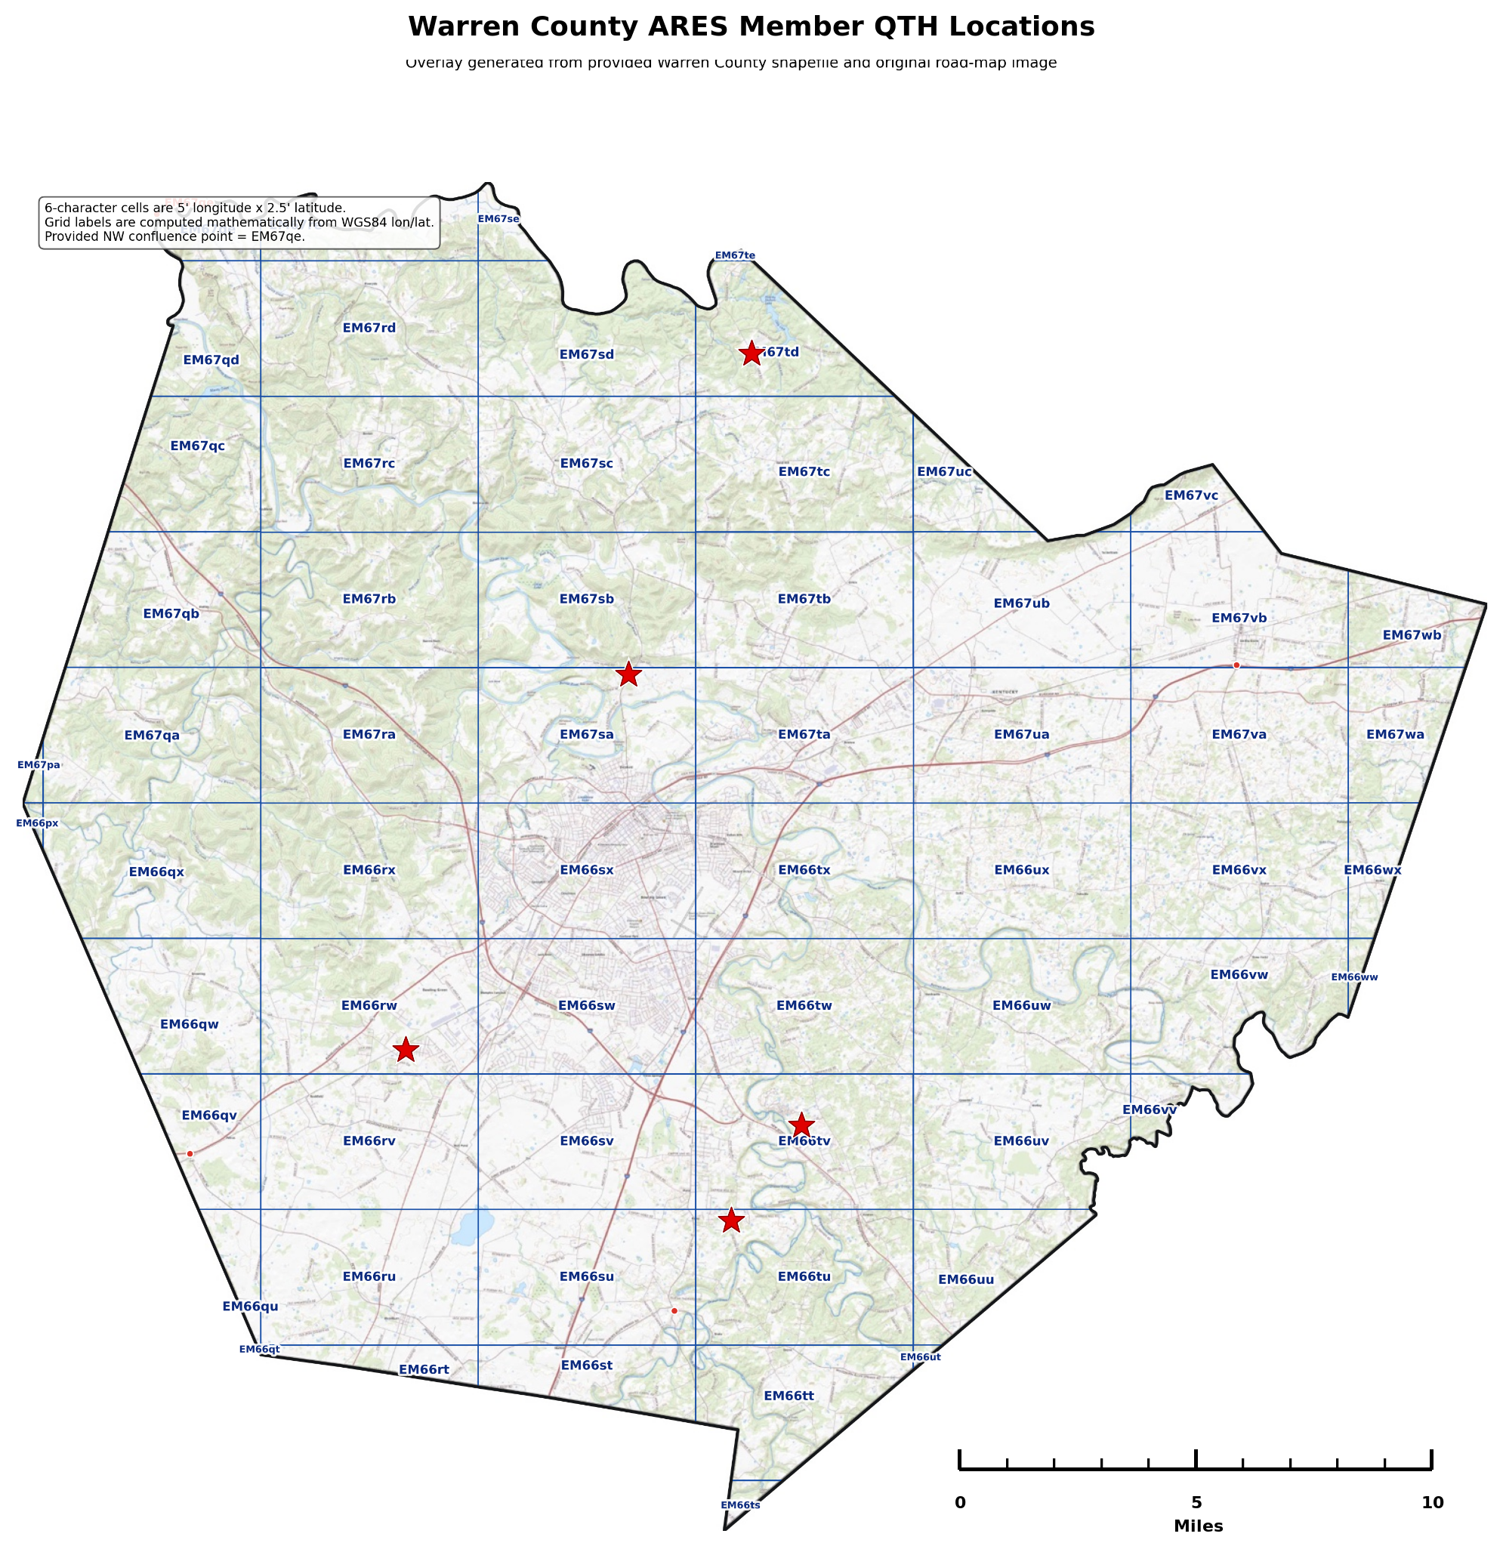
Theory
Most communication will center around Bowling Green.
This will test lower power communication distance up to 10 miles from BG with varying terrain types
Lower power will simulate extended periods of off-grid communication to an EOC while reserving battery life where possible
NCS will use a portable 2m antenna from an elevated position with an HT while field stations will use HT normal antennas
Basically, worst case scenario, especially in the first 1-12 hours of activation
If Repeater 1 is busy, use Repeater 2
If Simplex 1 is busy, use Simplex 2

Slide 4
Locations
NC
WKU Parking Structure
1a-K4WKU Highland Church
2500 Highland Church Rd.
2a-KY4JPS Otter Creek Church
299 Otter Gap Rd
3a-K9CHS Greenhill Church
4802 Old Greenhill Rd
4a-KD9GRD Clear Fork Baptist Church
303 Clear Fork Church Spur Rd
1a
2a
NC
4a
3a

Slide 5
Procedure
Everyone in place at start time
Tune to Repeater
NCS performs roll call
Switch to Simplex
Switch to low power
Will wait 3 minutes to complete
Perform roll call
Check for relays
Switch to high power
Will wait for 3 minutes to complete
Perform roll call
Check for relays
Switch to Repeater
Quick roll call
Summarize/review
Close

Slide 6
Exchanges
Roll call
NCS: KQ4TIV this is net control, how copy?
KQ4TIV: Net control this is KQ4TIV. Copy you 5-5, 5-5, Fifty-five
NCS: Roger that KQ4TIV, I copy you 5-6, 5-6, Fifty-six
If no copy:
NCS: KQ4TIV not heard, KQ4ABC, can you copy KQ4TIV?
KQ4ABC: Roger that. KQ4TIV this is KQ4ABC, how copy Net Control?
KQ4TIV: KQ4ABC this is KQ4TIV, I copy Net Control 5-7, 5-7, fifty-seven
KA4ABC: Roger that KQ4TIV. Net Control, KQ4TIV copies you 5-3, 5-3, fifty-three.
Or: KQ4ABC this is KQ4TIV, no copy on net control.
KQ4BC: Roger that. Net Control this is KQ4ABC, KQ4TIV does not copy Net Control. I copy KQ4TIV 5-3, 5-3, fifty-three. What instructions for KQ4TIV?

